Slide 1


Slide 2
Creative Force
Developer
Founded: 2020.
We want to make fun and engaging games that are creative and take it to the next level.

Slide 3
Company Development Team

Slide 4
CyberFocus
CyberFocus is a first person, parkour, time bending experience players will find fun and creative.

Slide 5
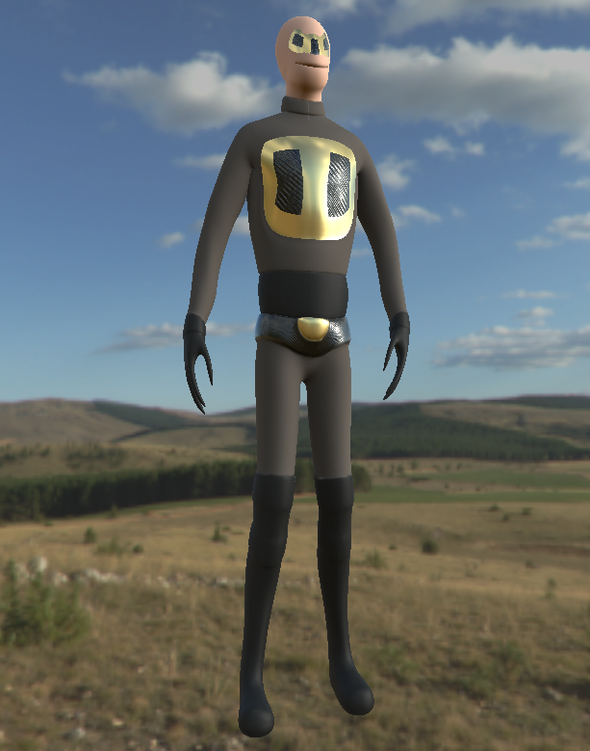
Parkour
Wall running
Vaulting, crouch sliding
Hook to propel player
Gifs here
Notes:
This slide will discuss what the game is. The quote is our elevator pitch - “CyberFocus is a first person shooter set in the future where players can bend time and parkour to outsmart their enemies in fun and unique ways.”
We aim to make the game feel unique with a blend of parkour and slow motion game mechanics
By incorporating these, we believe that this creates a fun and engaging experience for players and adds a lot of replayability.

Slide 6
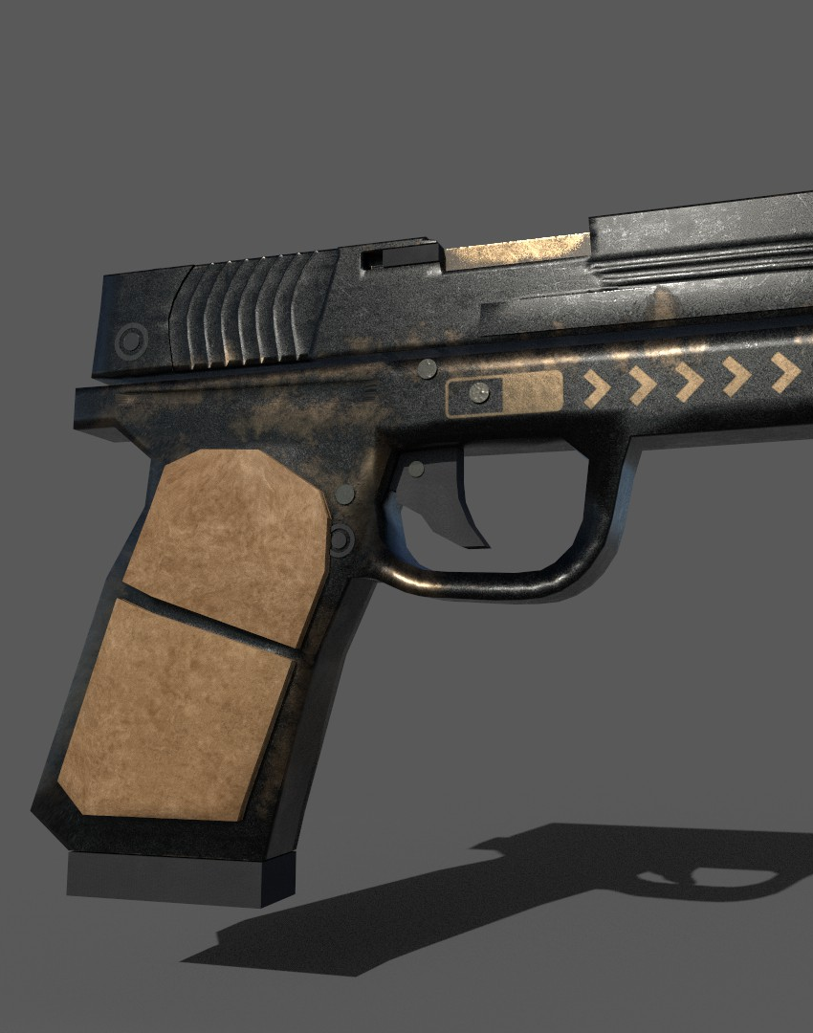
Time Control
The world slows around the player
Bullets, enemies slow for satisfying results.
Creative when mixed with parkour
Gifs here
Notes:
Backstory: set in the future, the player is designed by a company that specialises in cyborg technology. With them being a cyborg, they have the ability to wall run, slow down time and parkour.
In the next slide we will discuss the 3 phase model we are creating for the player to follow and understand the game better.

Slide 7
Combat
Real time
Bullets slow down (similar to SuperHot)
Parkour with this combat to produce enjoyable results.
Gifs here
Notes:
Backstory: set in the future, the player is designed by a company that specialises in cyborg technology. With them being a cyborg, they have the ability to wall run, slow down time and parkour.
In the next slide we will discuss the 3 phase model we are creating for the player to follow and understand the game better.

Slide 8
Marketing Plan
Conference + Trade Shows | Self-Publish for PC → Curve Digital (Publisher)
Trailers | Own YouTube Channel
Community Building | Twitter/YouTube/Discord
PR + Marketing | Contractor -> Curve Digital
Notes:
Backstory: set in the future, the player is designed by a company that specialises in cyborg technology. With them being a cyborg, they have the ability to wall run, slow down time and parkour.
In the next slide we will discuss the 3 phase model we are creating for the player to follow and understand the game better.

Slide 9
Production Timeline
June
Wall Running
Community Building
PR + Marketing
July
Wall Running
Community Building
PR + Marketing
August
Wall Running
Community Building
PR + Marketing
September
Wall Running
Community Building
PR + Marketing
Notes:
Backstory: set in the future, the player is designed by a company that specialises in cyborg technology. With them being a cyborg, they have the ability to wall run, slow down time and parkour.
In the next slide we will discuss the 3 phase model we are creating for the player to follow and understand the game better.

Slide 10
Budget
Game Development Burn rate for the month | £30,000
Music and Sound design
Localisation
QA
PR + Marketing PR, Targeted Advertising, Marketing Spend
Porting
TOTAL
Notes:
Backstory: set in the future, the player is designed by a company that specialises in cyborg technology. With them being a cyborg, they have the ability to wall run, slow down time and parkour.
In the next slide we will discuss the 3 phase model we are creating for the player to follow and understand the game better.

Slide 11
Funding
Studio Investment | £££££
Patreon
Us
TOTAL
Notes:
Backstory: set in the future, the player is designed by a company that specialises in cyborg technology. With them being a cyborg, they have the ability to wall run, slow down time and parkour.
In the next slide we will discuss the 3 phase model we are creating for the player to follow and understand the game better.

Slide 12
Questions
What is it?
Why is it fun?
Why would someone want to play it?
Notes:
Backstory: set in the future, the player is designed by a company that specialises in cyborg technology. With them being a cyborg, they have the ability to wall run, slow down time and parkour.
In the next slide we will discuss the 3 phase model we are creating for the player to follow and understand the game better.

Slide 13
Studios game Experience
Calum – Team Leader/ Programmer
Has lead various teams in and out of university and knows how to set deadlines appropriately.
Knows how to keep the team organised and in close contact
Worked on various solo projects outside of university to improve C# knowledge.
Brodie – Programmer
Proficient in C#, attended game jams (experience working in teams and sticking to deadlines) and always open to feedback.
He knows that issues are part of the development cycle and is prepared for them.
Pawel – Level Designer
Comfortable with the Unity engine, experience creating levels and always suggests new ideas and ways of overcoming obstacles in development and creating UI art.
Engages in team meetings and always wants to improve.
Samuel – 3D Modeller
Experience collaborating with different teams (games and animation students)
Experienced in environment and character modelling and able to stick to deadlines.
Notes:
Backstory: set in the future, the player is designed by a company that specialises in cyborg technology. With them being a cyborg, they have the ability to wall run, slow down time and parkour.
In the next slide we will discuss the 3 phase model we are creating for the player to follow and understand the game better.

Slide 14
3 phase model
Phase 1 – Understanding the game.
Phase 2 – Test the players understanding of the game by placing a challenge in front of them.
Phase 3 – Ensure player understands the game by having them complete the most challenging part of the level but by also making it still feel fun and engaging.
Notes:
Phase 1 is the introduction phase (introduce them to the mechanics, the story etc).
Phase 2 is the challenge stage (once players understand the game better, place a challenge in front of them and make them overcome it themselves to prove they understand it)
Phase 3 is the final stage where players utilise all they have learned in the final part of the level and ensure it is creative enough so it is fun and feel new.

Slide 15
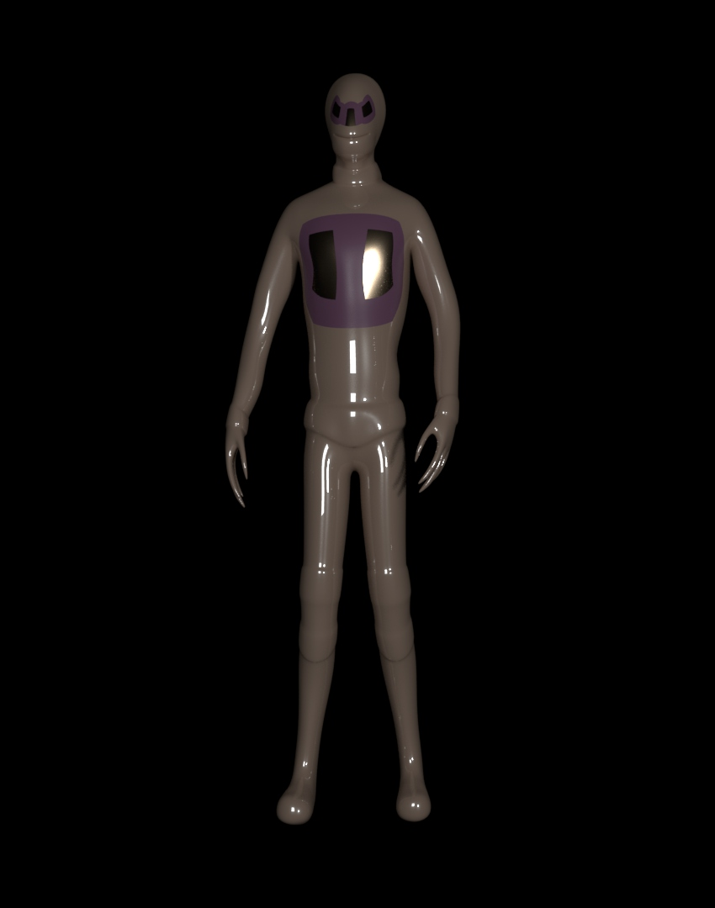
Why is is it fun?
We believe CyberFocus will excite players by giving them the ability to approach encounters in fun and engaging ways.
With the ability to wall run, slow down time, parkour and shoot, players can be creative with how they want to take on enemies and manoeuvre levels.
Notes:
We feel that bringing a game like this to the market will provide a breath of fresh air as something like this has not been released in a long time.

Slide 16
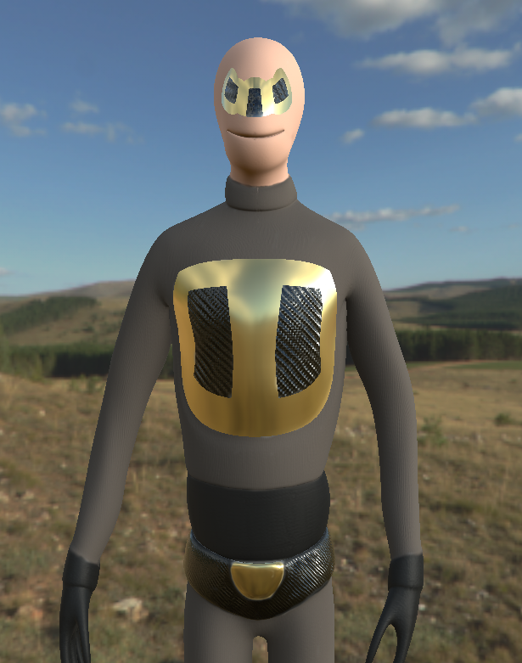
Why would someone want to play it?
As it is a first person shooter, most players will feel comfortable with the controls layout as FPS are mainstream in the current gaming world.
We feel the game would be appealing as having a mix of gunplay, parkour and slow motion would be fun for players. We hope they find a similarity to games such as Mirrors Edge to help with them understanding the controls and general gameplay.
Notes:
This would attract more players as most people are familiar with the FPS genre.

Slide 17
Innovation
To say our game is completely new and innovative to the market would not be true. We are taking aspects from popular games and adding our own creative twist to it.
Games on the market such as Mirrors edge and Titanfall are both very popular, mainly due to the parkour mechanics mixed with gun play. With CyberFocus, we hope players find the controls familiar from playing games like these.
There has not had a memorable parkour fps since Titanfall or Mirrors Edge, so, with CyberFocus we can bring back interest by promoting this on the market and grab the attention from possible players.
The games innovation will fill the gap by bringing familiar mechanics to the fps genre but mixed with new fun and engaging mechanics that players will want to try and experiment with.

Slide 18
Shipping
We plan to gauge the success of the game by self publishing first on PC and then approaching a publisher for a console release if the game becomes more financially successful.
Release date: March 2021
In order to build excitement for the game we have decided to use “Screenshot Saturday” as a way of keeping people updated with the game.
Can use Youtubers to advertise our game in a way screenshots or text can’t by showing raw gameplay. It is also a great way for testing and finding new bugs or ways people play the game compared to how we do.
Notes:
Release for pc and provide controller support for PC.
Publisher: we have planned the deadline for the game March next year. We feel having a publisher means we can receive further funding and receive some help when bringing the game to console. It is important to ensure the game is fitted well for PC and working on console which means changing controls and UI elements as well as graphics to enhance performance.
Release date: we have chosen next year for a full release as we intend to have the game polished and have all the features planned to be in the game and any new ones if time allows.
Over the course of the development of the game, we intend to build a community from scratch.
When considering how to handle tax, we have decided to research and find and accountant to set aside more time to concentrate on the game. However, it is important to ask potential accountants the right questions so they are the right one for us.
We must also make sure we know the reddit communities we are posting to first before just posting onto a page.
Building a community from scratch: Using sites such as reddit and twitter for our dev diary for updates and build excitement.
Screenshot Saturday: example -Any new art or game feature we have developed will be featured on screenshot Saturday to build the anticipation.
Revenue model - This will allow us to keep players invested and spread their enjoyment of the game to bring in more potential users.

Slide 19
Commercial sustainability
Revenue model: We intend to fully release the game onto Steam by the release deadline. With the extra time post Tranzfuser, we can polish the game further.
Be able to demonstrate that you plan to create and grow a sustainable studio post-competition.
• Expert knowledge of the business and the project and be able to talk at ease about all aspects.
• Financial / Commercial
o Clear understanding of sources of finance, where you will generate income both whilst in this development phase and afterwards - i.e. other funders, publishers, selling assets etc. Think about life beyond the possible UK Games Fund grant fund.
We plan to use Patreon as an extra source of income during the project. Using this allows us to have specific tiers give subscribers benefits and help the development of the game. it will also allow us to also recruit more contractors if needed and add DLCs to the game.
Press outreach and PR: Hire a contractor to do PR. We intend to do this post Tranzfuser. The same can be said for an accountant to handle taxes.
o Demonstrate that your budget and projected costs are realistic and in-line with publisher’s project budgets.
Read into book that covers this
• Impact
o What would the impact of securing the UK Games Fund support have on your team / company?
Securing funding from the UK Games Fund will allow the company to hire an accountant and PR personnel which will help the team work on the game and not have to worry about other aspects of the game outside its development.
o Are there other impacts that are not purely commercial?

